Slide 1



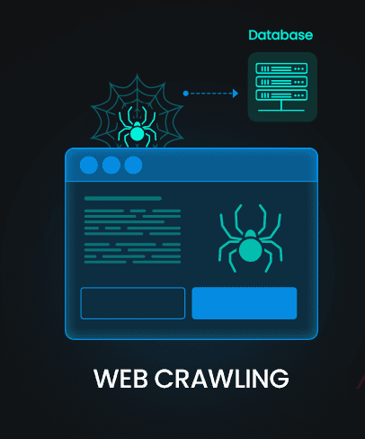
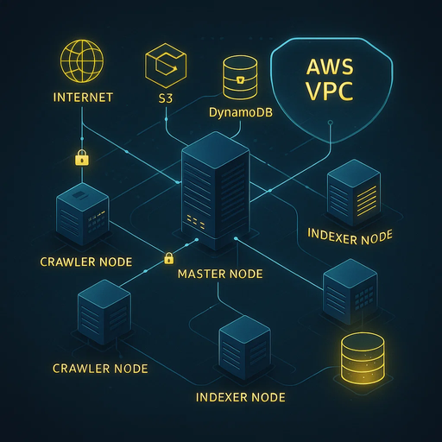

Introduction
Architecture
Demo
Fault tolerance
Beneficiaries
Conclusion
Contact
DISTRIBUTED WEB CRAWLING

Slide 2

DISTRIBUTED WEB CRAWLING
Team Members :
Alaa Yasser Fathy
Mohamed Abdelraouf
Adham Osama
Seif Elden
Supervisor :
Prof. Ayman Mohamed Bahaa Eldin , Eng. Alaa Hamdy

Slide 3

TABLE OF CONTENTS
01
INTRODUCTION
04
FAULT TOLERANCE
02
ARCHITECTURE
05
BENEFICIARIES
03
06
CONCLUSION
DEMONSTRATION

Slide 4

Introduction
Architecture
Demo
Fault tolerance
Beneficiaries
Conclusion
Contact
INTRODUCTION
Distributed Web Crawling and Indexing System using Cloud Computing, is a robust, scalable solution designed to efficiently collect, store, and index vast amounts of web data.
Built using a modular architecture and AWS cloud services, it supports distributed task execution, fault tolerance, and web page interfaces for seamless web crawling and information retrieval.

Slide 5
Introduction
Architecture
Demo
Fault tolerance
Beneficiaries
Conclusion
Contact
02
ARCHITECTURE

Slide 6
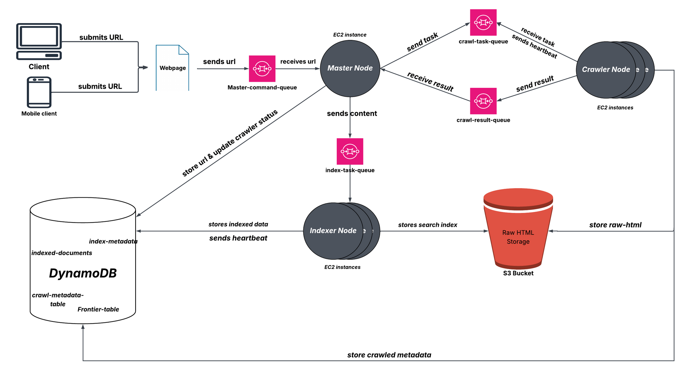
Introduction
Architecture
Demo
Fault tolerance
Beneficiaries
Conclusion
Contact

Slide 7




Introduction
Architecture
Demo
Fault tolerance
Beneficiaries
Conclusion
Contact
MAIN COMPONENTS
MASTER NODE
INDEXER NODES
Manages task distribution
Processes and indexes crawled content using Whoosh
CRAWLER NODES
DYNAMO DB
perform the Polite web crawling using scrapy
Contains Tables for storing status, html, indexed docs

Slide 8
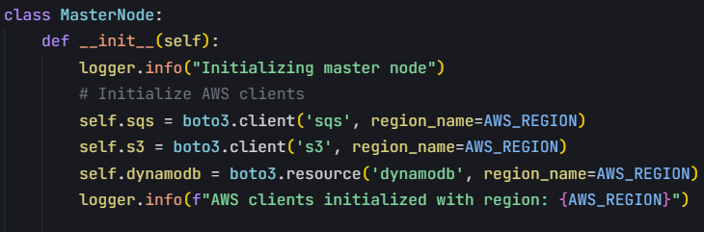
Introduction
Architecture
Demo
Fault tolerance
Beneficiaries
Conclusion
Contact
MASTER
NODE
INDEXER NODES
1 Receives URLs from master-command queue
3 Tracks active crawlers through heartbeats
MASTER NODES
MASTER NODES
4 Forwards crawled content to indexer
2 Adds URLs to the crawl queue
Manages task distribution
Manages task distribution

Slide 9
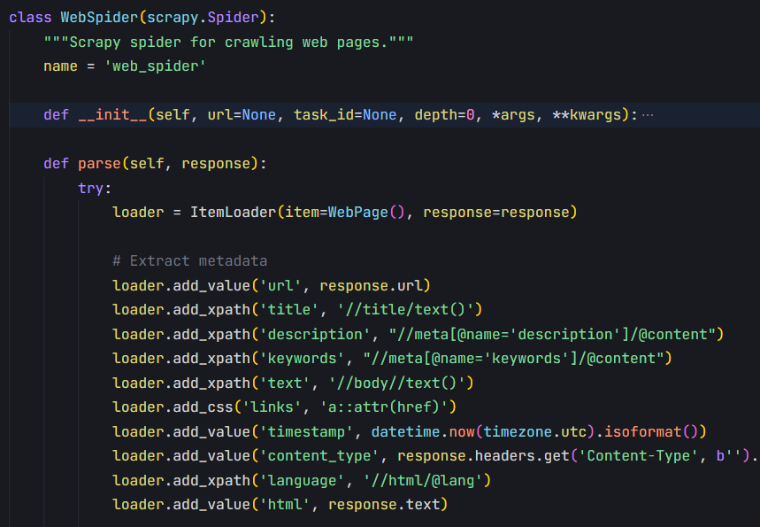
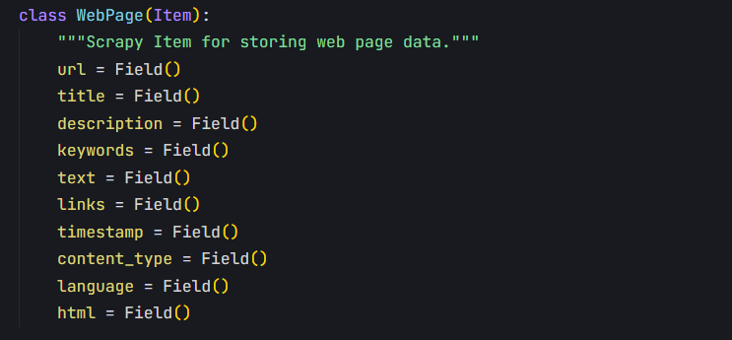
Introduction
Architecture
Demo
Fault tolerance
Beneficiaries
Conclusion
Contact
CRAWLER
NODE
2 WebSpider : Scrapy spider for crawling web pages
(3 CLASSES)
INDEXER NODES
1 WebPage: Scrapy Item class for storing web page data

Slide 10
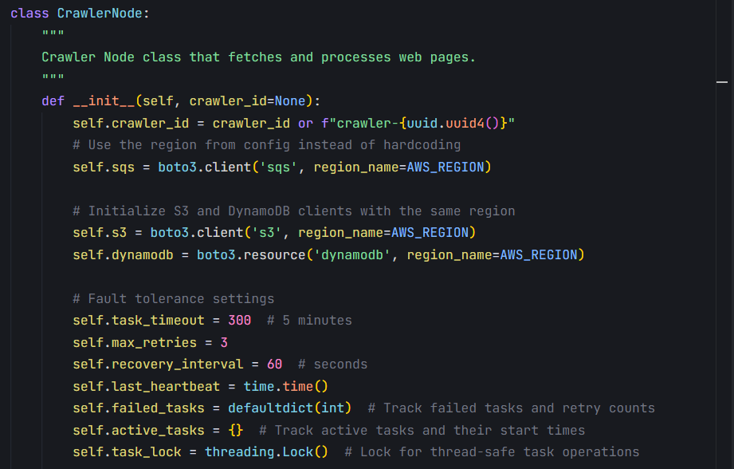
Introduction
Architecture
Demo
Fault tolerance
Beneficiaries
Conclusion
Contact
3 CrawlerNode : Main crawler node class
CRAWLER
NODE
1 Data Extraction :
- Page metadata
(title, description, keywords)
- Raw HTML
- Links for further crawling
- Language and content type

Slide 11
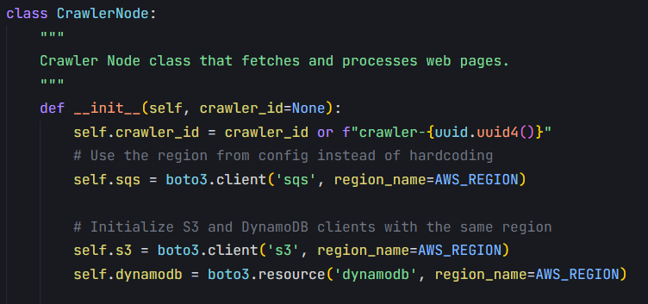
Introduction
Architecture
Demo
Fault tolerance
Beneficiaries
Conclusion
Contact
CRAWLER
NODE
INDEXER NODES
2 Sends periodic Heartbeat for Master node
4 Store in Dynamo DB :
crawled urls in frontier table
Crawled metadata
MASTER NODES
3 Store raw html in s3 bucket
Manages task distribution

Slide 12
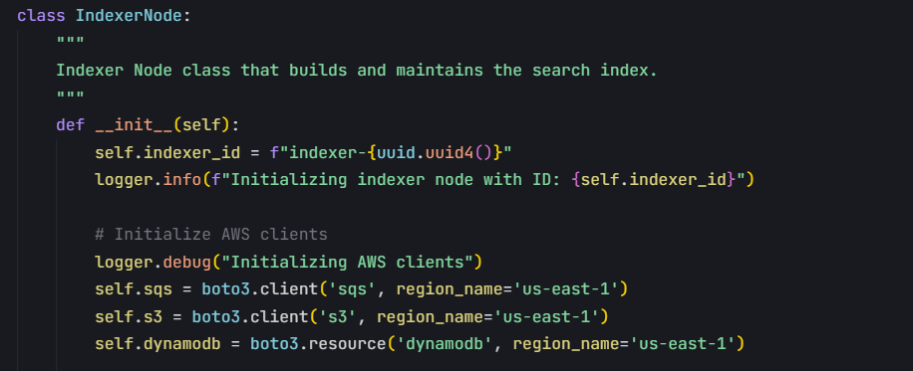
Introduction
Architecture
Demo
Fault tolerance
Beneficiaries
Conclusion
Contact
INDEXER
NODE
INDEXER NODES
1 Receives URLs from master queue
3 Periodically saves its status in Dyanmo DB
MASTER NODES
MASTER NODES
4 Uses WHOOSH INDEX for indexing
2 Adds URLs to the crawl queue
Manages task distribution
Manages task distribution

Slide 13
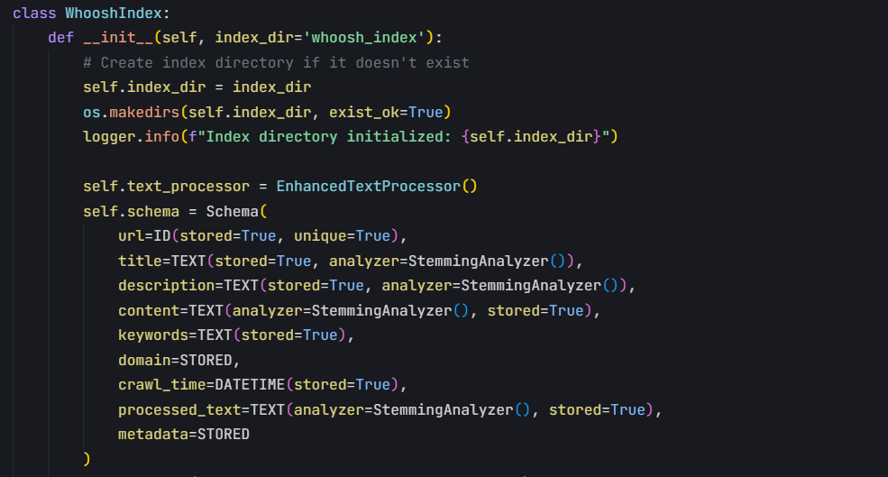
Introduction
Architecture
Demo
Fault tolerance
Beneficiaries
Conclusion
Contact
INDEXER
NODE
Whoosh Index : used for indexing and search
Structure index documents
Provide multi-field search
MASTER NODES
Indexer saves every 10 docs in s3 bucket
Manages task distribution

Slide 14
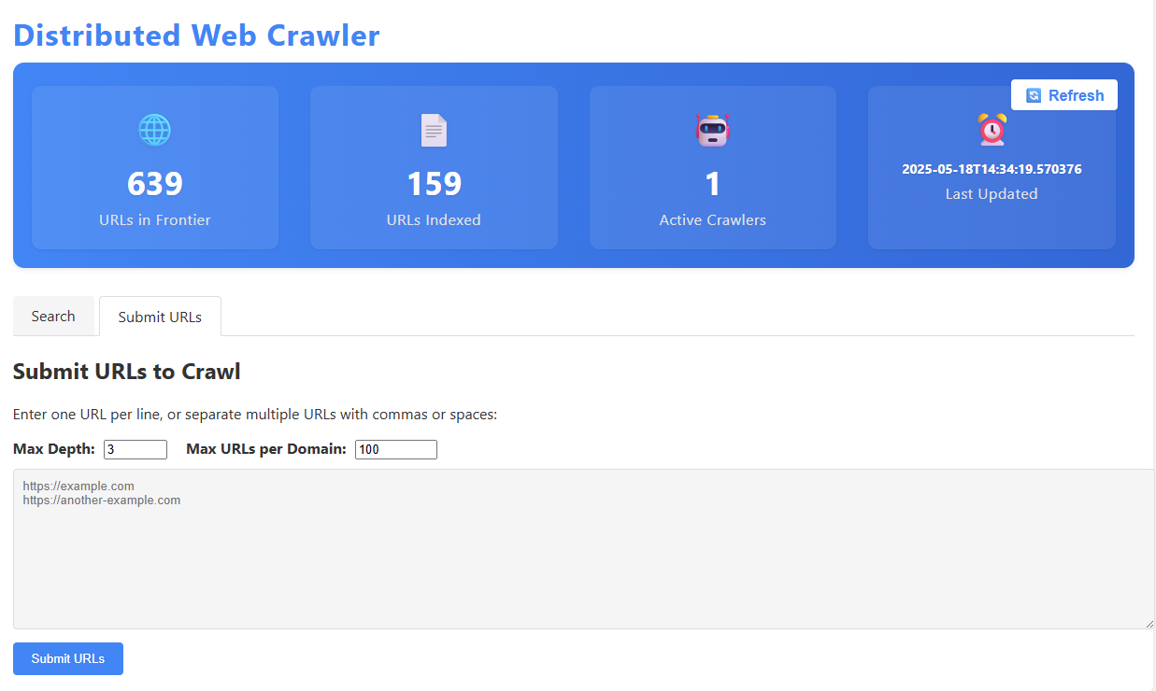
Introduction
Architecture
Demo
Fault tolerance
Beneficiaries
Conclusion
Contact
DEMONSTRATION
CLIENT

Slide 15
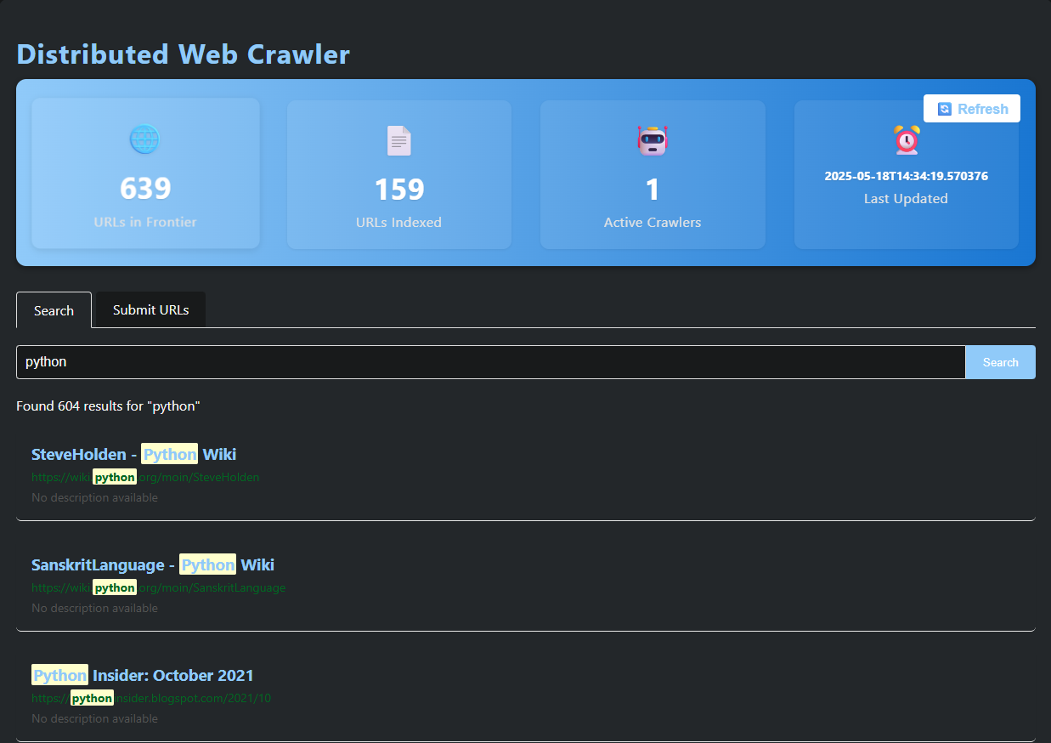
Introduction
Architecture
Demo
Fault tolerance
Beneficiaries
Conclusion
Contact
DEMONSTRATION
CLIENT

Slide 16
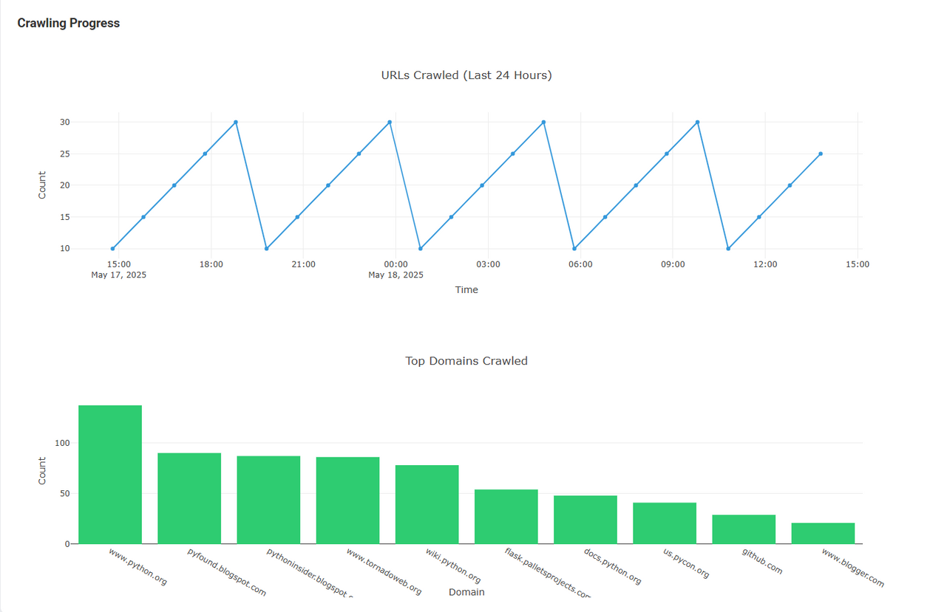
Introduction
Architecture
Demo
Fault tolerance
Beneficiaries
Conclusion
Contact
DEMONSTRATION
DASHBOARD

Slide 17
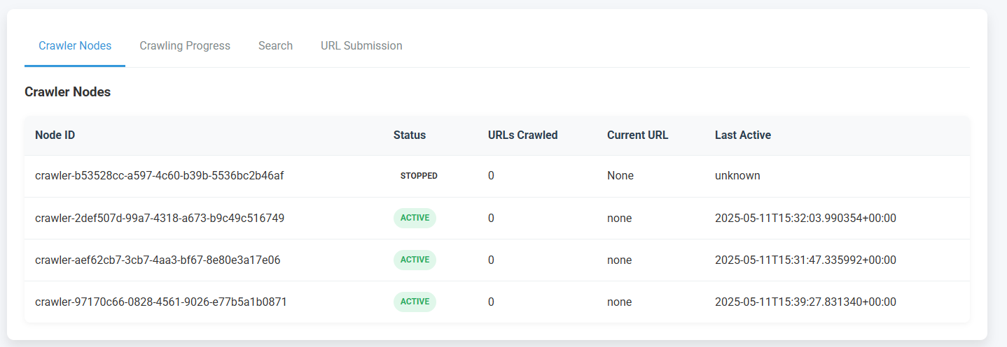
Introduction
Architecture
Demo
Fault tolerance
Beneficiaries
Conclusion
Contact
DEMONSTRATION
DASHBOARD

Slide 18
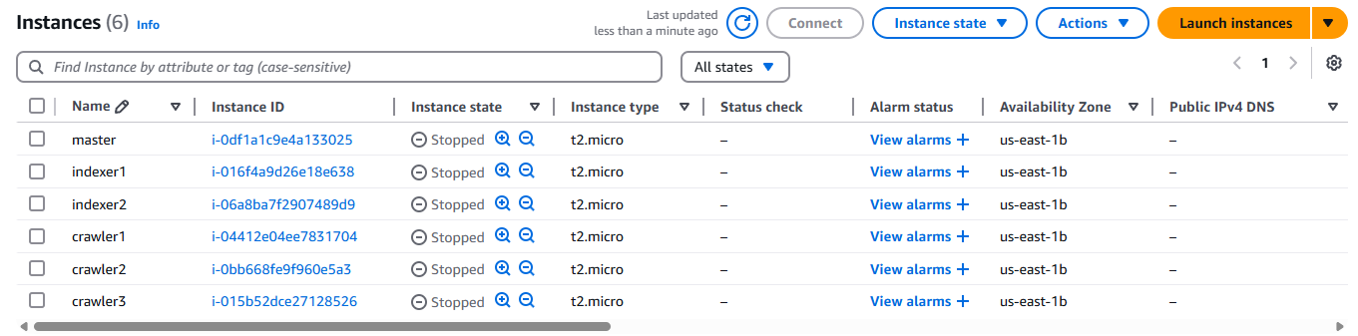
Introduction
Architecture
Demo
Fault tolerance
Beneficiaries
Conclusion
Contact
DEMONSTRATION
AWS EC2

Slide 19
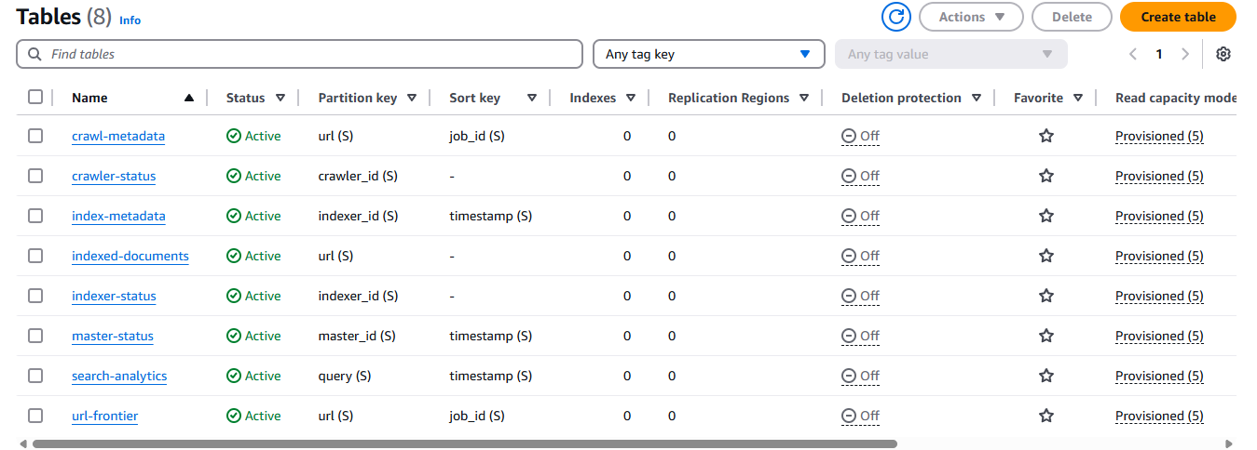
Introduction
Architecture
Demo
Fault tolerance
Beneficiaries
Conclusion
Contact
DEMONSTRATION
AWS DYNAMO DB

Slide 20
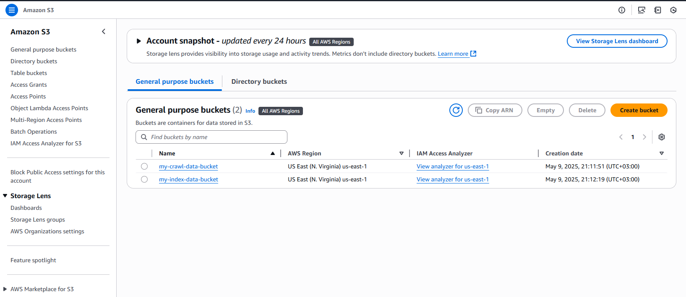
Introduction
Architecture
Demo
Fault tolerance
Beneficiaries
Conclusion
Contact
DEMONSTRATION
AWS S3

Slide 21
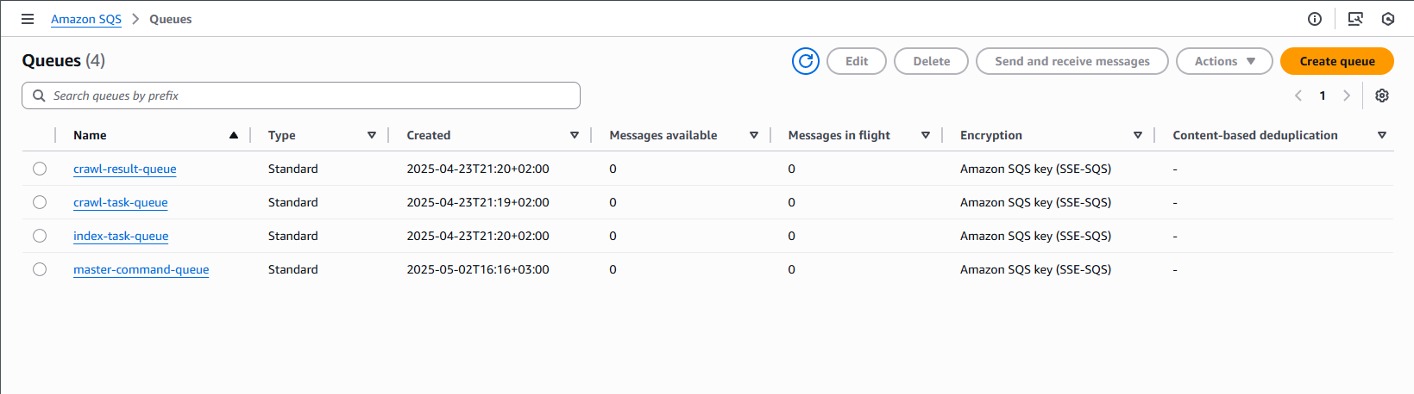
Introduction
Architecture
Demo
Fault tolerance
Beneficiaries
Conclusion
Contact
DEMONSTRATION
AWS SQS

Slide 22
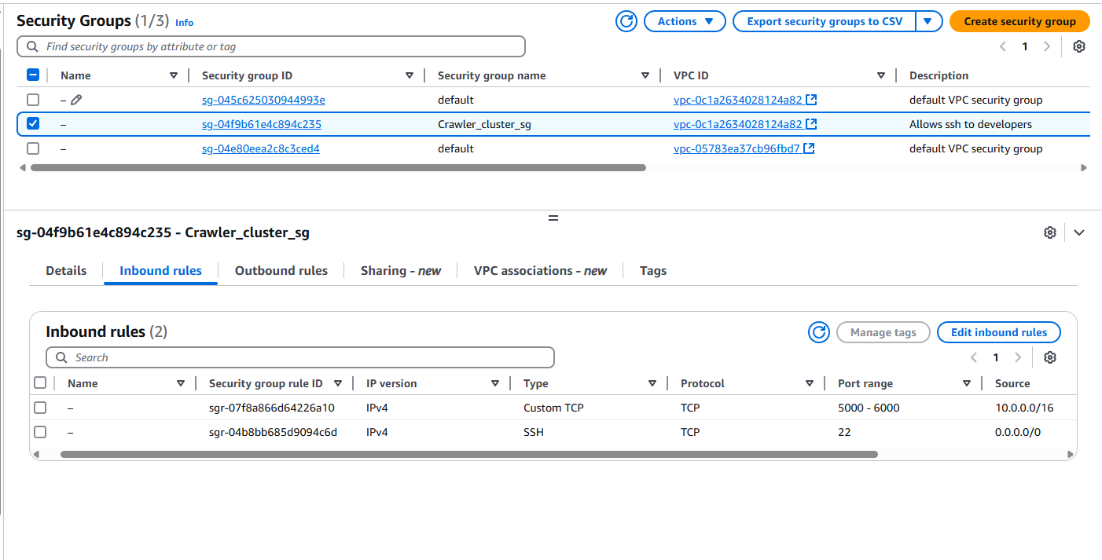
Introduction
Architecture
Demo
Fault tolerance
Beneficiaries
Conclusion
Contact
DEMONSTRATION
AWS SECURITY GROUP

Slide 23
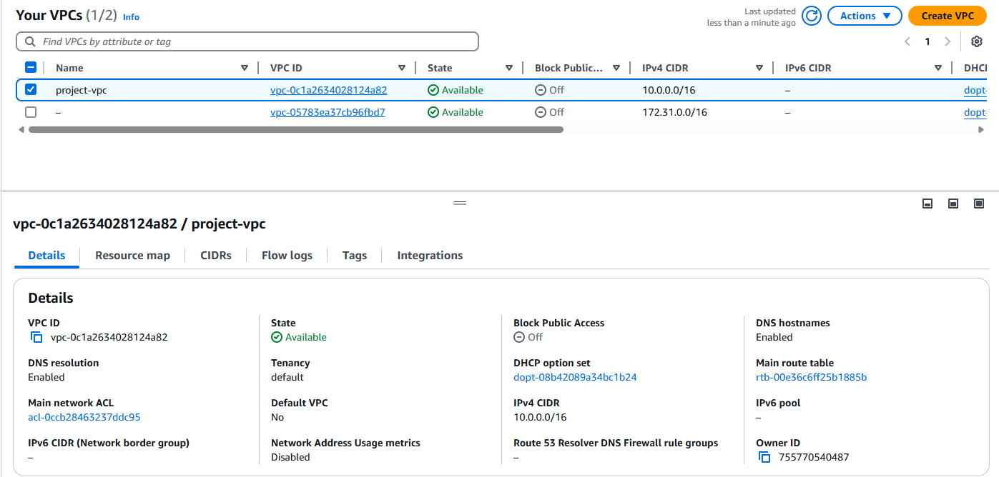
Introduction
Architecture
Demo
Fault tolerance
Beneficiaries
Conclusion
Contact
DEMONSTRATION
AWS VPC

Slide 24
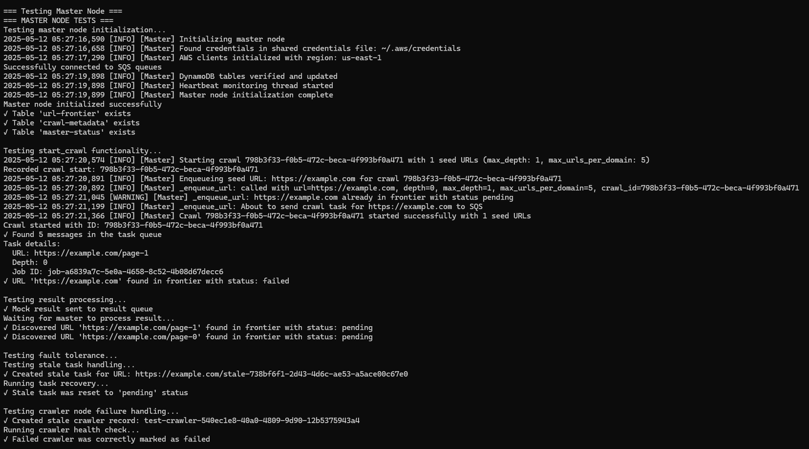
Introduction
Architecture
Demo
Fault tolerance
Beneficiaries
Conclusion
Contact
MASTER
NODE FUNCTIONALITY

Slide 25
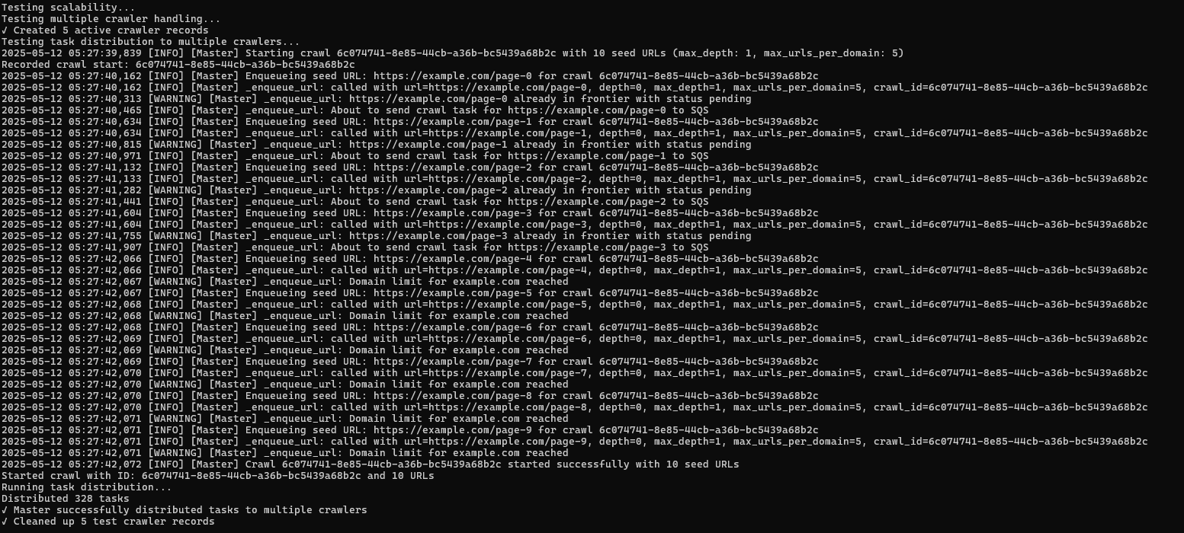
Introduction
Architecture
Demo
Fault tolerance
Beneficiaries
Conclusion
Contact
MASTER
NODE FUNCTIONALITY

Slide 26
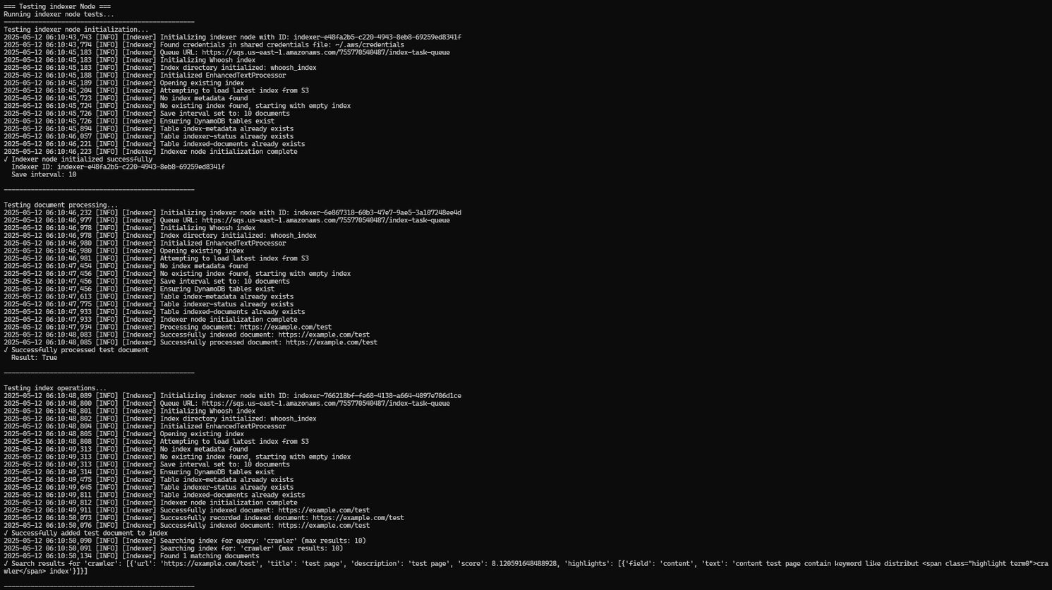
Introduction
Architecture
Demo
Fault tolerance
Beneficiaries
Conclusion
Contact
INDEXER
NODE FUNCTIONALITY

Slide 27
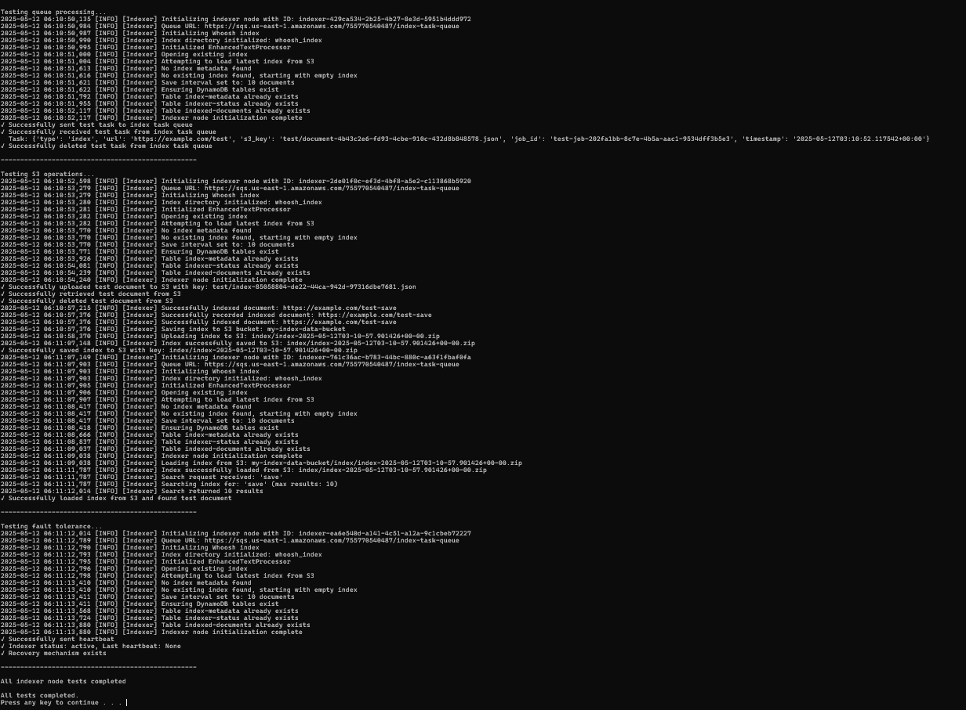
Introduction
Architecture
Demo
Fault tolerance
Beneficiaries
Conclusion
Contact
INDEXER
NODE

Slide 28
Introduction
Architecture
Demo
Fault tolerance
Beneficiaries
Conclusion
Contact
FAULT TOLERANCE STRATEGY
Heartbeat Monitoring:
Each crawler and indexer node sends periodic heartbeat signals to the master node. Missing heartbeats trigger recovery.
Timeout Detection:
Tasks that take too long are flagged as stale. The master node marks them for reassignment.
Automatic Task Reassignment:
If a node fails or disconnects, its uncompleted tasks are returned to the queue and reallocated to healthy nodes.
Persistent State Storage (DynamoDB):
Crawl state, task metadata, and node statuses are saved so the system can recover after crashes.
Recovery & Retry Logic:
Failed tasks are retried a limited number of times, with backoff and logging.

Slide 29
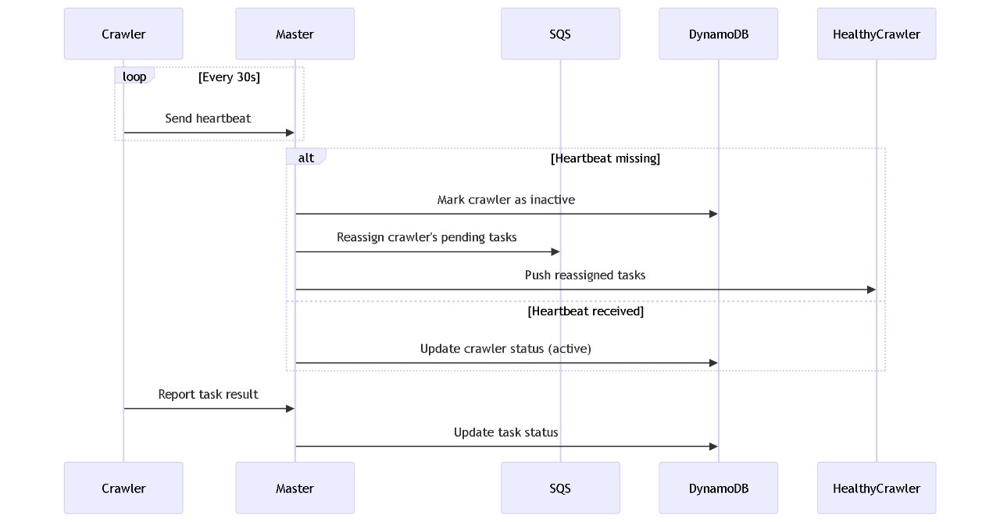
Introduction
Architecture
Demo
Fault tolerance
Beneficiaries
Conclusion
Contact
FAULT TOLERANCE STRATEGY

Slide 30
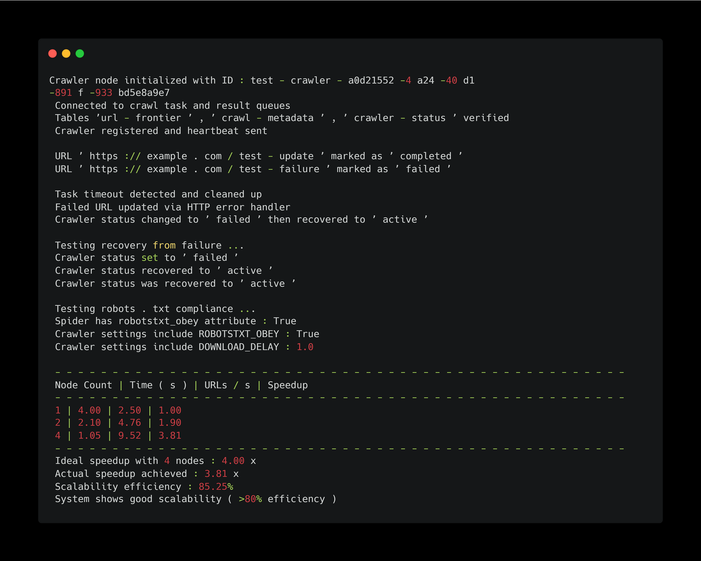
Introduction
Architecture
Demo
Fault tolerance
Beneficiaries
Conclusion
Contact
FAULT TOLERANCE STRATEGY

Slide 31

Introduction
Architecture
Demo
Fault tolerance
Beneficiaries
Conclusion
Contact
BENEFICIARIES
ACADEMIC RESEARCHERS
NEWS AGGREGATORS & JOURNALISTS
Business Intelligence Teams
GOVERNMENT
& NGOs

Slide 32
Introduction
Architecture
Demo
Fault tolerance
Beneficiaries
Conclusion
Contact
CONCLUISON
distributed web crawler system represents a well-balanced approach to the complex problem of web crawling at scale.
It effectively combines distributed systems principles
with cloud services and modern text processing techniques, resulting in a solution that is both
powerful and maintainable.
The clear separation of concerns across different components makes
the system modular and extensible, while the comprehensive fault tolerance mechanisms ensure
reliability in production environments.

Slide 33
Introduction
Architecture
Demo
Fault tolerance
Beneficiaries
Conclusion
Contact
THANK YOU

